Slide 1
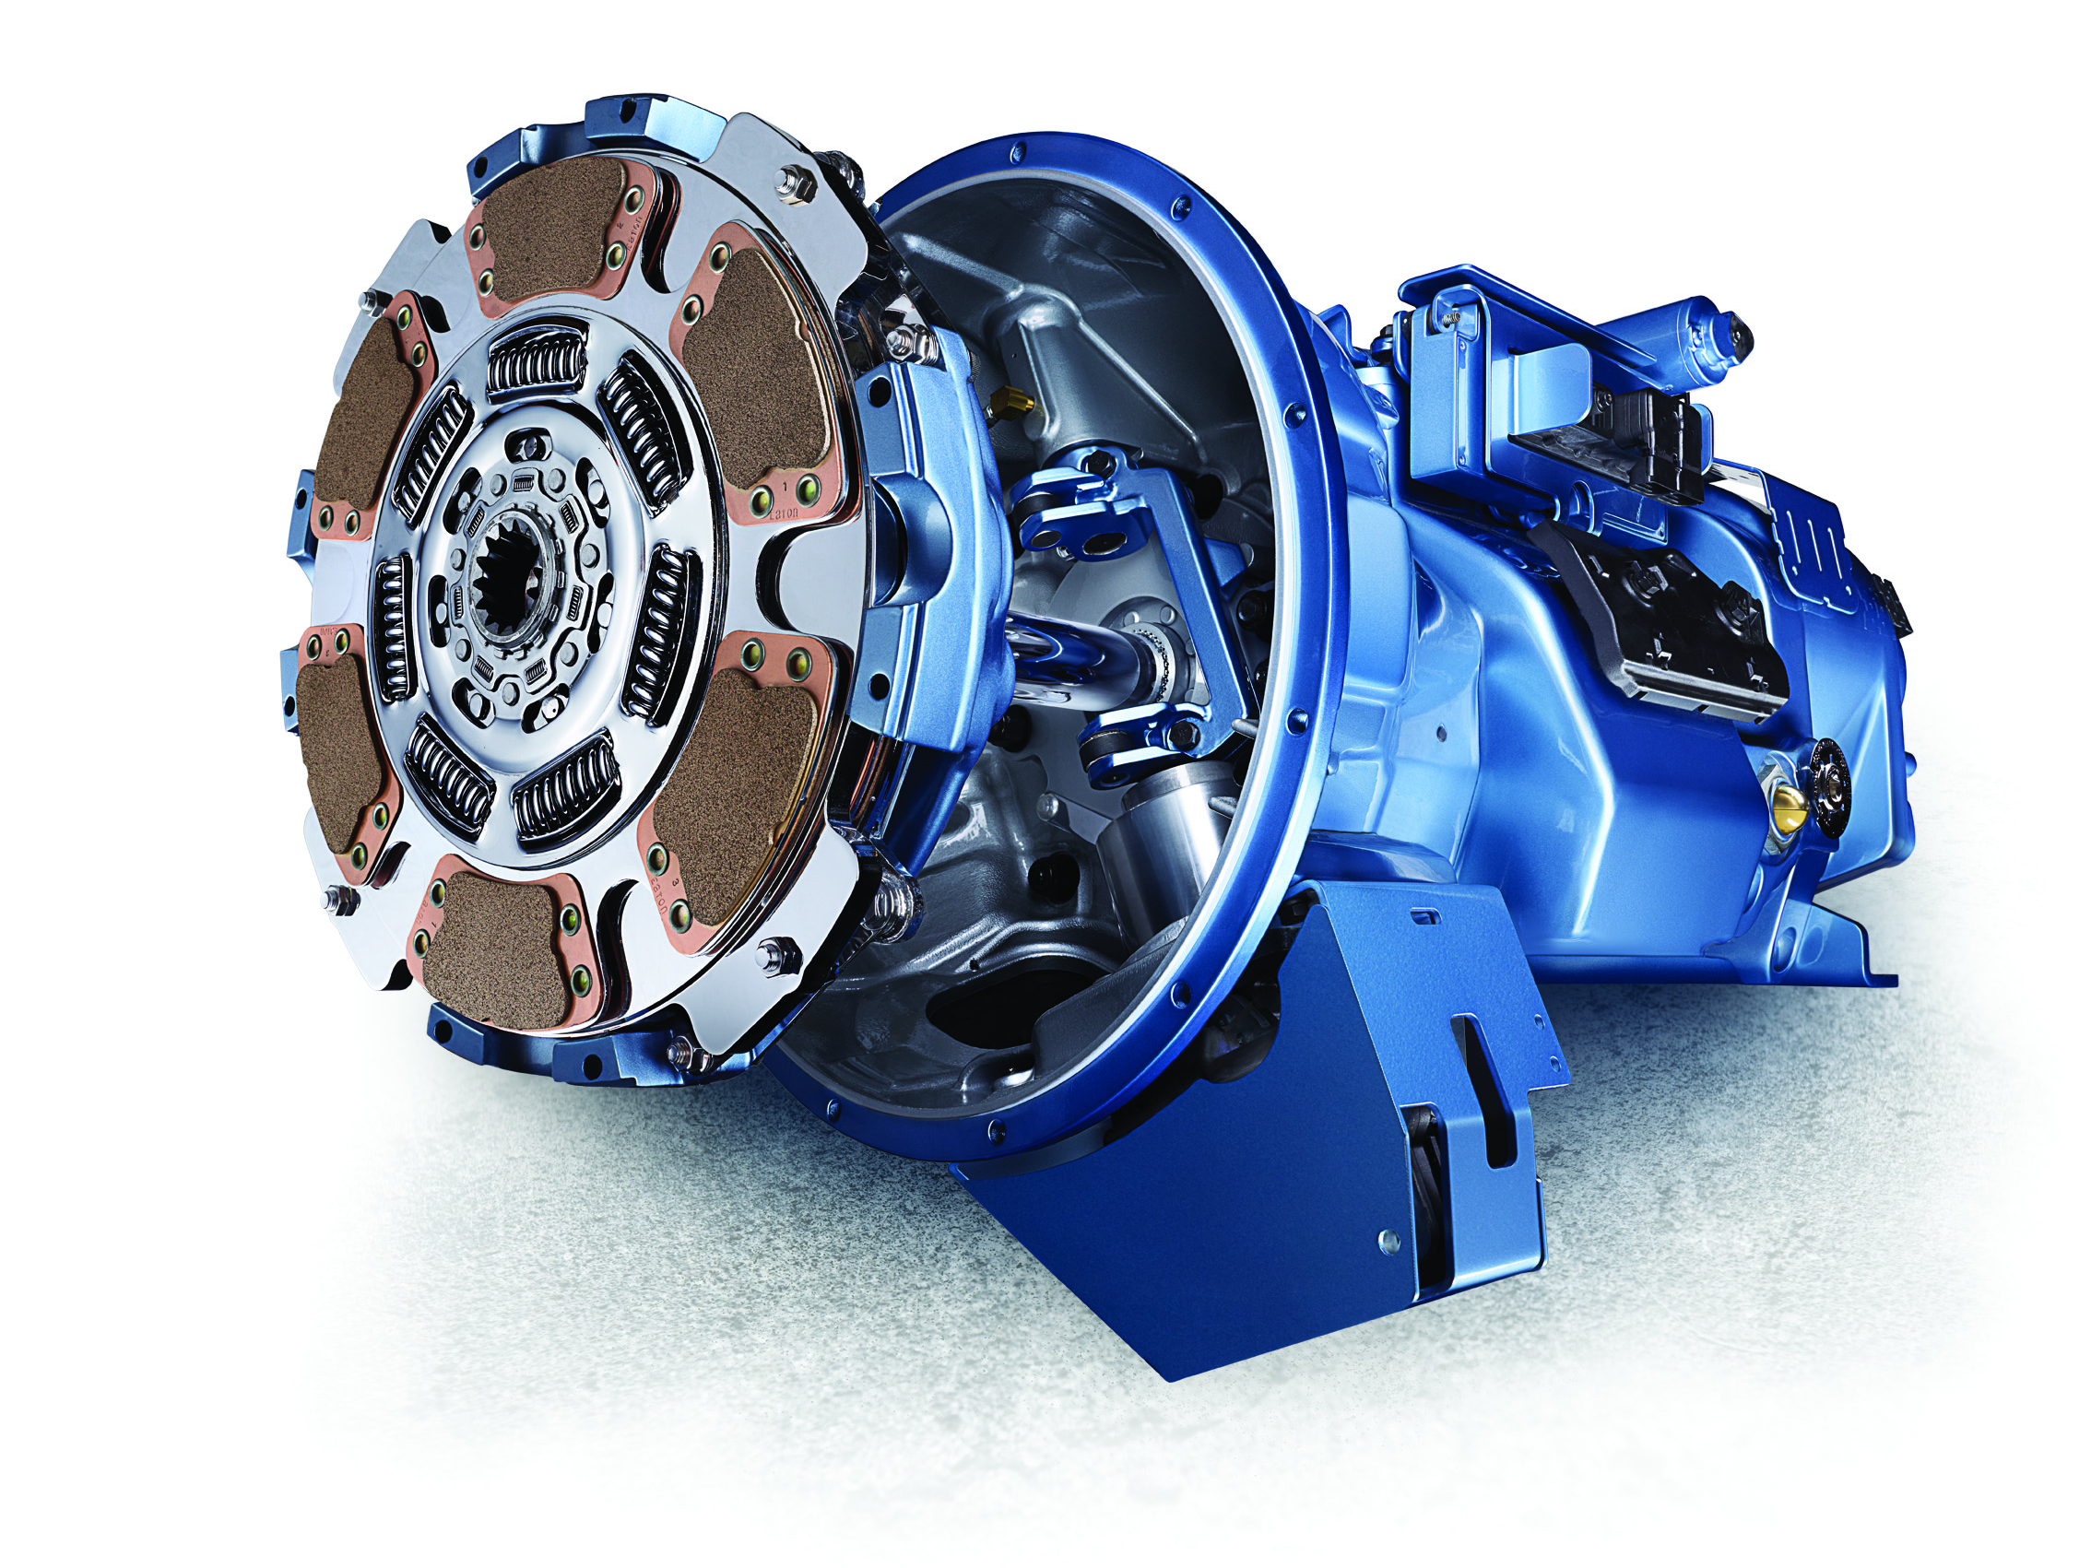


Eaton UltraShift PLUS Automated Transmissions

Slide 2
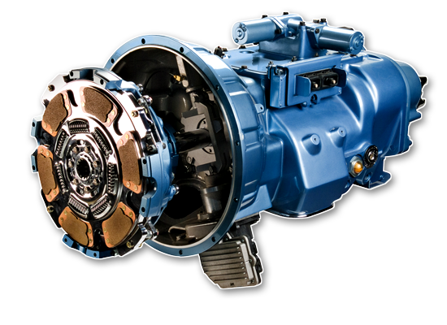
UltraShift® PLUS
What is the Eaton UltraShift Plus Transmission? AMT
All launches & shifts are automated
Clutch operation is fully automated (2-pedal)
  Uses Electric Clutch Actuator (ECA) and a unique automated clutch
  Fast, smooth engagement
6 platforms available for Vocational, Performance and Linehaul applications

Slide 3
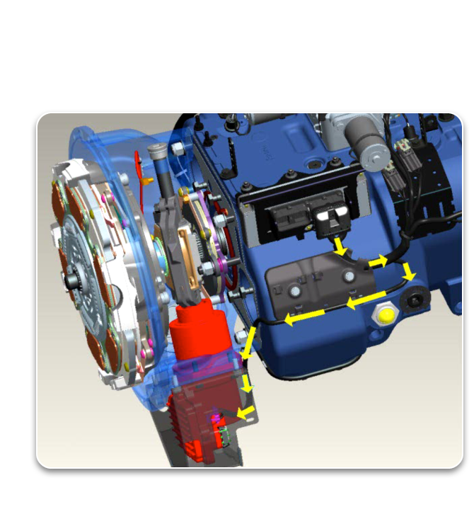
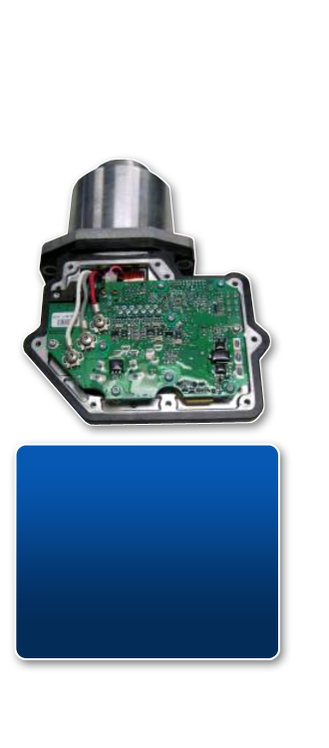
Electric Clutch Actuation Technology
Gradeability:
UltraShift PLUS 25%
UltraShift 8%

Slide 4
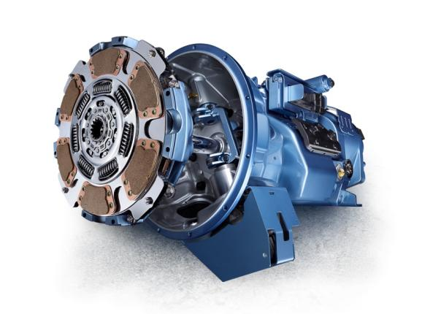
UltraShift PLUS Offers Solutions
Fuel Efficiency
Performance
Warranty
Safety
Service-ability
Driveability

Slide 5
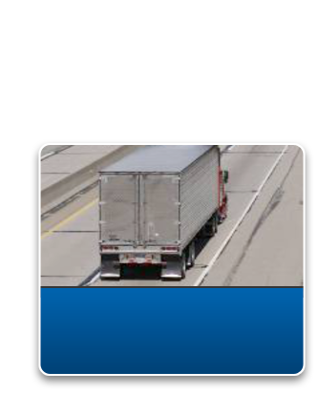
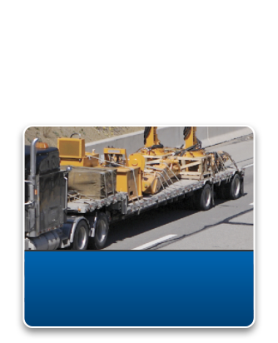
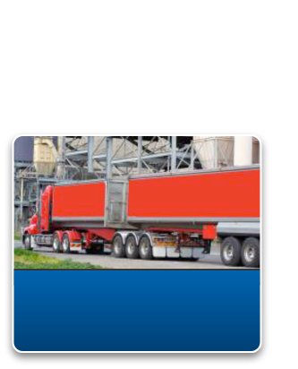
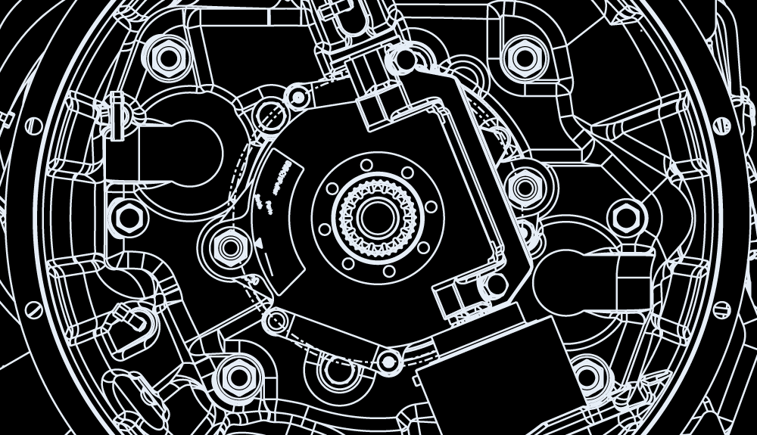
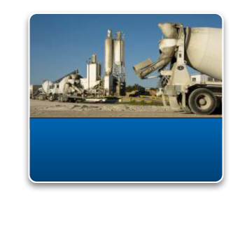
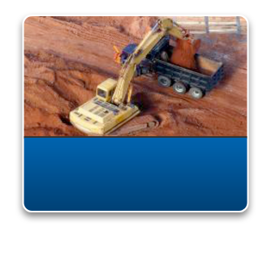
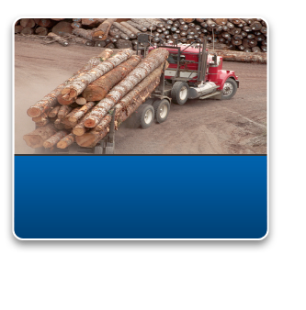
UltraShift® PLUS Transmissions…
Linehaul, Vocational, Heavy Haul
LAS
Linehaul Active Shifting
MHP
Multipurpose High Performance
MXP
Multipurpose Extreme Performance
VMS
Vocational Multipurpose Series
VCS
Vocational Construction Series
VXP
Vocational Extreme Performance
5
Notes:
5

Slide 6
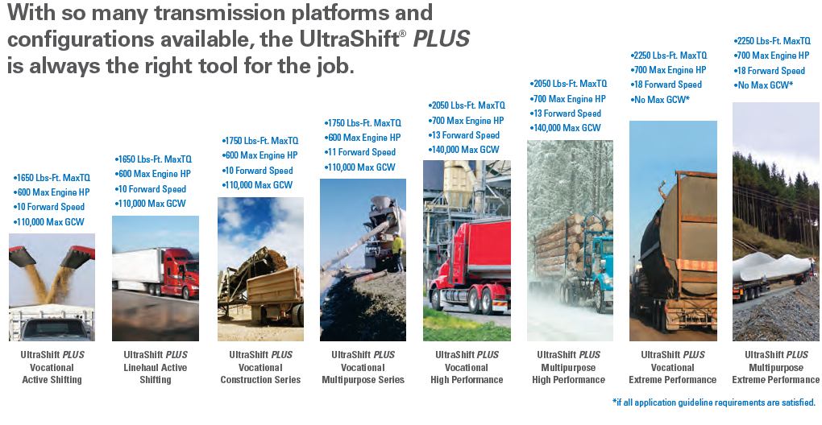
UltraShift PLUS Transmissions

Slide 7
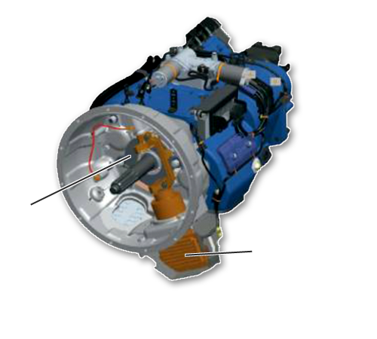
UltraShift® PLUS Features
Fully integrated electronics, grade sensor
Intelligent shift decisions based on grade, vehicle weight, available engine torque and throttle position
Hill Start Aid – prevents roll back on grades
Low speed maneuverability
Automatic start gear select
Skip shifting
6 & 8 bolt PTO availability
Oil level sight glass
Clutch Brake
Electric Clutch
Actuator

Slide 8
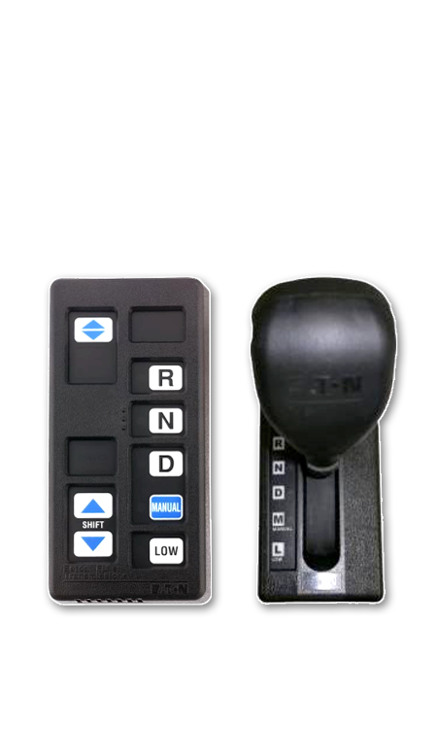
Ease of Use
Simple & intuitive driver interface
  Fully automated, 2-pedal operation
Multiple operating modes
  Drive
  Reverse
  Manual
    Driver override on demand and fall-back mode
  Low
    Maximizes engine braking

Slide 9
Safety Features
Hill Start Aid
Auto Neutral
Low Mode - engage on down grades
“Creep” feature with no “urge to move”
Grade & weight sensing
Engine over speed & clutch abuse protections
Stall prevention

Slide 10
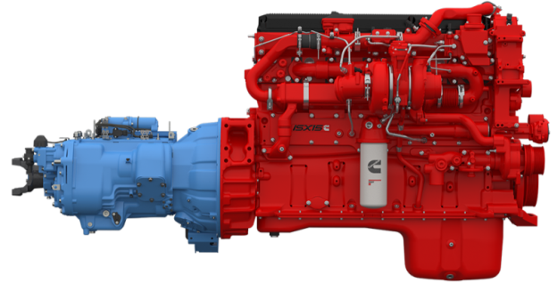
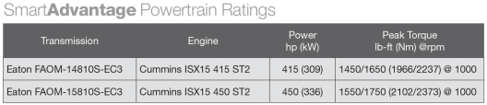
The SmartAdvantage Powertrain
3-6% Better Fuel Economy
Smooth Shifting
Optimized Performance
Linehaul - Only
80,000 GCWR
Notes:
The Cummins ISX15 with SmartTorque2 is totally integrated with the Eaton Fuller Advantage 10-speed automated transmission. The engine and transmission share critical data, which helps determine the torque curve and power level need to match real-time load demand. This optimizes performance and fuel economy as a total until.

Slide 11
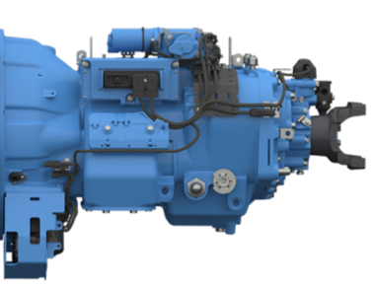
The Fuller Advantage 10-Speed
Automated Transmission – EC Series
Better Fuel Economy
  Precision Lubrication System
  Small-Step Gearing In Top 2 Gears
  Strategic Use of Aluminum
Increased Uptime
  Oil Level Sight Glass
  Cooler-less Design
Latest automation technology
  Electronic Clutch Actuation
  Intelligent Shifting
  Enables Downspeeding in Top Gear
  Skip Shifts
  Hill Start Assist
Notes:
This new constant mesh transmission, is the first transmission from Eaton to feature a cooler-less design to improve reliability and fuel economy while providing you with the highest level of efficiency. The cooler-less partial dry-sump Precision Lubrication system reduces the oil “churn” and overall energy losses found in conventional transmissions by nearly one-third.
Less heat is generated using less horsepower which eliminates the need for a cooler (including lines and fittings). Therefore, cooler system maintenance is no longer required. Also, with the use of a simple oil level sight glass, routine oil checks can be done in a fraction of the time.
Weight savings can be attributed to strategic use of aluminum for the shift bar housing, rear cover, and range cylinder. Eliminating the oil cooler provides additional weight savings. Up to 82 pounds of weight savings are normal compared to the comparable manual transmission.
Small-step gearing puts the engine into a more efficient operating range when a downshift is needed. It also enables downspeeding in top gear.
As you’d expect from Eaton, the Fuller Advantage Automated transmissions come with all the features of Eaton’s renowned UltraShift PLUS. Such as hill start assist, clutch abuse protection, manual mode, auto neutral, optional stall prevention and much more.
It uses electronics to engage and disengage the clutch, so drivers can concentrate on the road, not shifting. Its Intelligent Shifting capability selects appropriate starting gear and makes shift decisions based on grade, vehicle weight, engine torque and throttle position – skip shifting when appropriate, and making the most efficient shift changes based on those conditions.
All these great features are now available with the added efficiency savings of the Fuller Advantage.

Slide 12
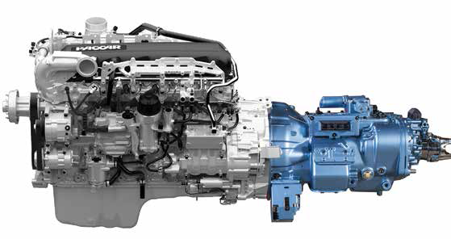
The Fuller Advantage/PACCAR MX-13 APEX Package
Better Fuel Economy – up to 5%
Smooth Shifting
Optimized Performance
Linehaul – Only
80,000 GCWR
Transmission | Engine | Power hp (kw) | Peak Torque lb-ft (NM) @RPM
FAO-16810S-EP3 | MX-13 | 455 [339] | 1650 [2237] @ 1000
 | MX-13 | 485 [360] | 1650 [2237] @ 1000
FAOM-15810S-EP3* | MX-13 | 430 [321] | 1550/1750 [2102/2373] @ 1000
 | MX-13 | 455 [339] | 1550/1750 [2102/2373] @ 1000
Multi-torque |  |  | ( * +200 lb-ft in top two gears )

Slide 13
Serviceability
Many common components – all models
OEM dealer, fleet familiarity
Serviceable at all OEM’s
Modular design minimizes cost and time of service
Advanced Gen 3 ServiceRanger 4 diagnostic capabilities
Keeps the repair is “YOUR” Shop!

Slide 14
UltraShift® PLUS Benefits
Easy operation for drivers with all experience levels
Optimal performance over the road or in tight spaces
Advanced safety features for operation on grades
Broad and comprehensive service network
Extended Protection Plans available
Roadranger support

Slide 15
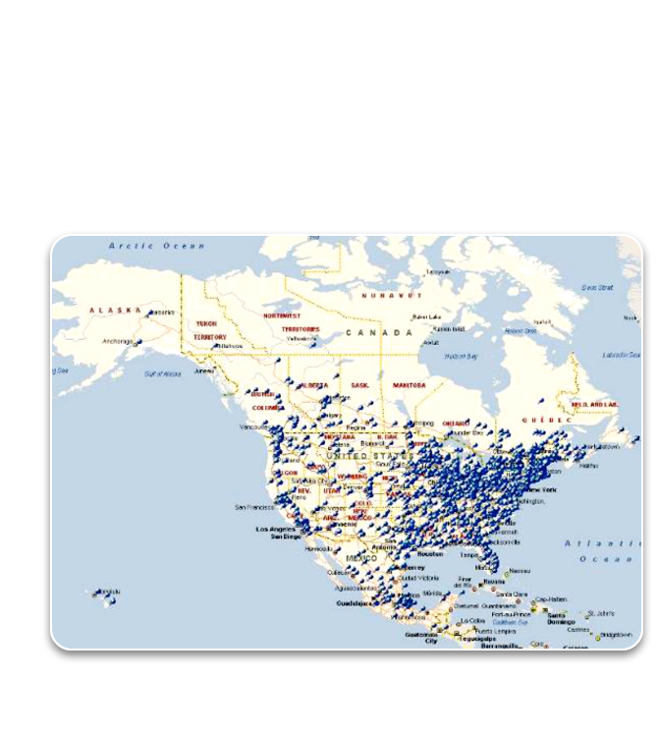
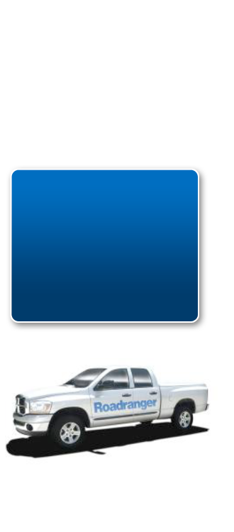
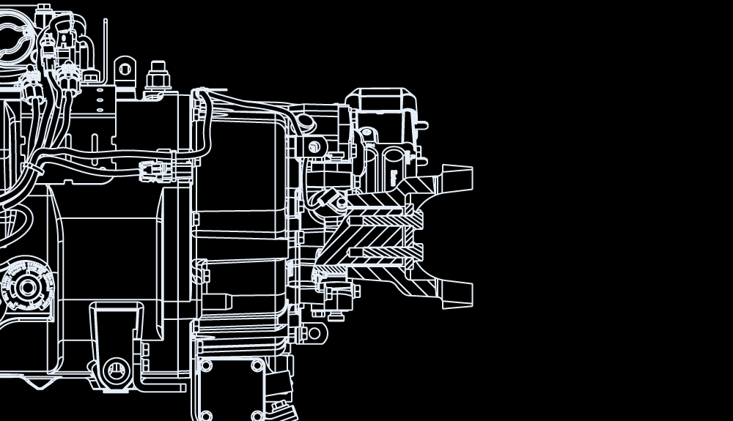
Wide Parts and Service Network
Eaton strives to provide its fleet customers with a world-class level of choices and options in terms of service providers.
Serviceable at more than 2,000 OEM truck dealers with more than 6,000 Roadranger-certified technicians
15
Notes:
15

Slide 16
UltraShift® PLUS
www.roadranger.com
Thank You!
?

Slide 17


